Slide 1
Midterm KTI
CLASS TI 1I
Group Members :
● Hammam Abdulllah Saeed (12)
● Faiz Atho’illah M. (17)
● Ahmad Adzin B. L. K. (2)
● M.Taqqiyuddin tsaqif (20)
● Ridho Anfa’al (23)

Slide 2
Development of Chipset and Motherboard Form Factor
1980 era
1990 era
2000 era
In the 1980s, motherboards used the AT (Advanced Technology) form factor which had a size of 12 x 11 inches. The chipsets used at that time were the 80286 and 80386 chipsets.
The motherboard uses an ATX (Advanced Technology Extended) form factor which measures 12 x 9.6 inches. This form factor allows for better and more expansion slot placement. The chipset used at that time was the Intel 430HX and 430VX chipset.
The motherboard uses a smaller ATX form factor with a size of 9.6 x 9.6 inches. This form factor allows the motherboard to be more compact and save space. The chipsets used at that time were the Intel 815 and 845 chipsets.
2010 era
2020 era
The motherboard uses a Mini-ITX form factor which measures 6.7 x 6.7 inches. This form factor allows the motherboard to be smaller and save space. The chipsets used at that time were the Intel H67 and Z68 chipsets.
Motherboards use the increasingly popular Mini-ITX and Micro-ATX form factors. This form factor allows the motherboard to be smaller and save space. The chipsets currently used are the Intel Z490 and AMD X570 chipsets.

Slide 3
PCI and PCIe slots on motherboards!
Both technologies have their advantages and disadvantages But In Summary,
PCIe is the newer, faster, and more advanced technology for connecting expansion cards to the motherboard, while PCI is an older, slower technology that is still present on some older motherboards today.
PCI Slots:
-PCI stands for Peripheral Component Interconnect, which is an older interface used for connecting expansion cards to the motherboard.
- PCI was first introduced in 1992 by Intel and is still found on some older motherboards today.
- PCI slots come in a standard size and shape, with a notch along the bottom to ensure compatibility with the expansion card.
- PCI slots support a maximum bandwidth of 133 MB/s, which limits their ability to handle data-intensive tasks.
- PCI cards are typically cheaper than PCIe cards and are sufficient for basic functions such as networking and sound.
- PCI slots are not compatible with PCIe cards, and vice versa

Slide 4
‘PcIe vs PcI’
PCIe Slots:
- PCIe stands for Peripheral Component Interconnect Express and is a newer, faster version of PCI for connecting expansion cards to the motherboard.
- PCIe was introduced in 2004 and is now the most commonly used interface for expansion cards.
- PCIe slots come in different sizes, including x1, x4, x8, and x16, with each size having a different number of data lanes for increased bandwidth.
- PCIe can support faster data transfer rates than PCI, with PCIe 4.0 providing speeds up to 16 GT/s
. - PCIe cards are typically more expensive than PCI cards, but are necessary for more data-intensive functions such as gaming and video editing.
- PCIe slots are not backward compatible with older PCI slots, so it’s important to ensure compatibility before purchasing an expansion card.
- PCIe also supports other advanced features, such as hot-swapping and multiple input/output lanes.
In Summary,PCIe is the newer, faster, and more advanced technology for connecting expansion cards to the motherboard, while PCI is an older, slower technology that is still present on some older motherboards today. Both technologies have their advantages and disadvantages, and the choice between them depends on the particular needs of the user and the compatibility with their current system.

Slide 5
I will explain the differences between data storage methods on HDD (Hard Disk Drive) and SSD (Solid-State Drive
Physical Components
SSD
HDD
HDD uses rotating platters coated with magnetic material to store data. This disk rotates at a certain speed, and reading and writing data is done through a moving reader head
SSDs do not have rotating platters. They are based on flash memory technology, where data is stored in semiconductor chips. This means the SSD has no moving parts.

Slide 6
Speed and perfomance
HDD
HDD performance is limited by the speed at which the platters rotate, which usually ranges from 5,400 to 7,200 RPM (rotations per minute). This results in slower access times
SSD
SSD is much faster in terms of speed because there are no moving parts. They have very fast access times and higher data transfer rates.

Slide 7
Shock Resistance & Energy Consumption
Shock Resistance HDD
Shock Resistance SSD
HDDs are susceptible to shock and vibration due to the rotating components inside them.
SSD is more resistant to shocks because it has no moving parts. This makes it more suitable for portable devices.
Energy Consumption from HDD
Energy Consumption SSD
HDD requires more power because the platters are spinning and the reader head is moving.
SSD requires less power because there are no moving parts, which makes it more efficient in terms of energy consumption.

Slide 8
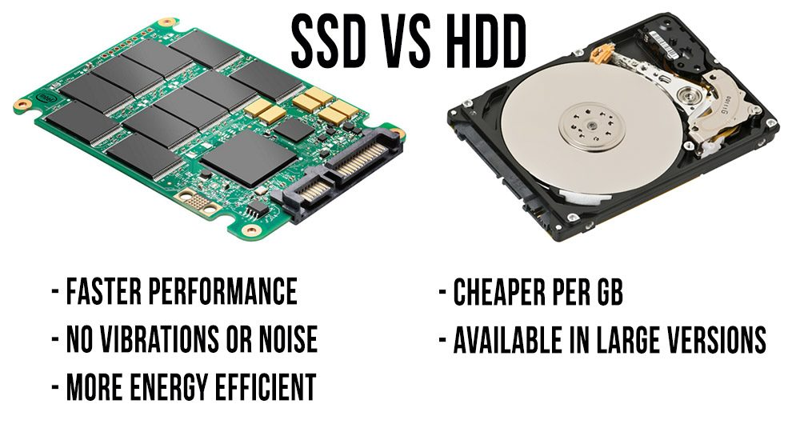
Size and Shape
HDD
SSD
HDDs are usually larger and heavier due to their mechanical components.
SSDs are lighter and have a smaller physical profile, making them a good choice for thin and light devices.

Slide 9
WHAT IS DDR IN RAM?
DDR in RAM is short for Double Data Rate. DDR is a RAM technology that allows data transfer twice in each clock cycle, thus increasing the speed of data transfer in RAM
DDR1 RAM
DDR2 RAM
DDR3 RAM
DDR1 RAM is the first generation of DDR RAM which was introduced in late 2000. DDR1 RAM has a maximum data transfer rate of 2.1 GB/s and a maximum capacity of 1 GB per chip
DDR2 RAM was introduced in 2003 and has a maximum data transfer rate that is double that of DDR1 RAM, at 4.2 GB/s. DDR2 RAM is also more power efficient and has a maximum capacity of 2 GB per chip
DDR3 RAM was introduced in 2007 and has a maximum data transfer rate of 8.5 GB/s. DDR3 RAM is also more power efficient and has a maximum capacity of 8 GB per chip
DDR4 RAM
DDR5 RAM
DDR4 RAM was introduced in 2014 and has a maximum data transfer rate of 17 GB/s. DDR4 RAM is also more power efficient and has a maximum capacity of 16 GB per chip
DDR5 RAM is the latest generation of DDR RAM which was introduced in 2020. DDR5 RAM has a maximum data transfer speed of 51.2 GB/s and a maximum capacity of 64 GB per chip

Slide 10
-How to read the VGA name!
The VGA name consists of three main components: the brand, series, and model number.
For Example here's how to break down the VGA name of the Nvidia RTX 3050 8GB DDR4 graphics card:
1. Brand - The brand of the graphics card is Nvidia, a well-known manufacturer in the graphics card market.
2. Series - The series of the graphics card is RTX, which is one of the most powerful and newest series of Nvidia graphics cards.
3. Model Number - The model number of the graphics card is 3050. This number denotes the card's position within the series and indicates its level of performance, with higher model numbers corresponding to more powerful graphics cards.

Slide 11
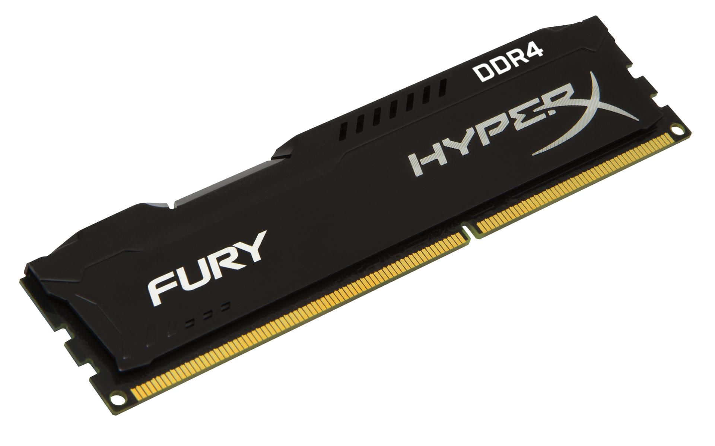
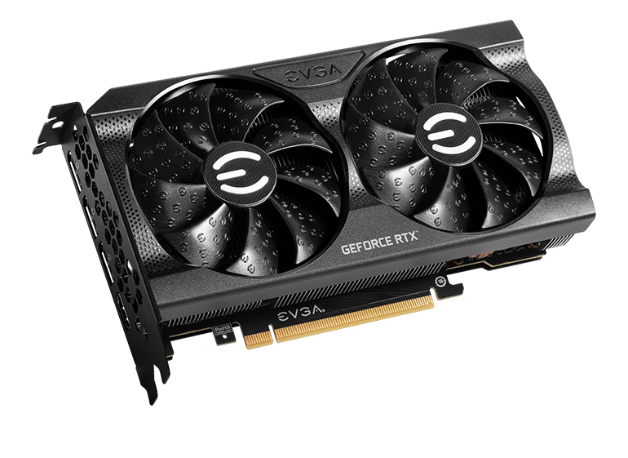
The VGA name also provides additional information, such as the size and type of its memory. In the case of the Nvidia RTX 3050 8GB DDR4 graphics card, "8GB DDR4" refers to the card's memory capacity and type.
The 8GB in the VGA name signifies that the graphics card has 8 gigabytes of memory available to use. This specification is vital for the card's performance, as it allows it to store and quickly access data to be used in rendering graphics.
DDR4 is short for Double Data Rate Fourth Generation. DDR4 is the most recent type of RAM, which is significantly faster and more efficient than older DDR3 RAM. The DDR4 specification of the graphics card ensures that it can perform well with modern requirements for gaming and other high-performance graphics-related tasks.
In conclusion, the Nvidia RTX 3050 8GB DDR4 graphics card, we can ascertain that it belongs to Nvidia's RTX series, has a model number of 3050, and has 8GB of DDR4 memory.

Slide 12
HIGH END GAMING PC

Slide 13
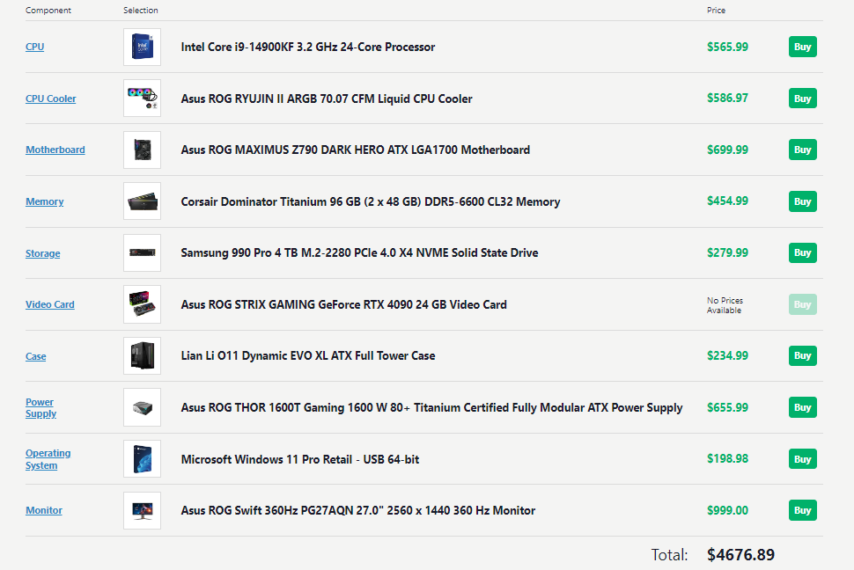

Slide 14
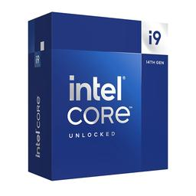
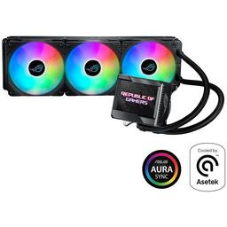
Intel Core i9-14900KF 24-Core Processor:
This CPU offers excellent multi-core performance and is well-suited for gaming and content creation tasks. The high core count ensures it can handle demanding games and applications without breaking a sweat.
Asus ROG RYUJIN II ARGB Liquid CPU Cooler:
Liquid coolers are efficient at keeping high-end processors cool, which is crucial for maintaining performance and longevity. The added ARGB lighting and monitoring display contribute to the aesthetics and functionality of the system.

Slide 15
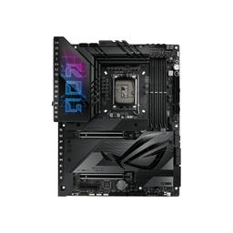
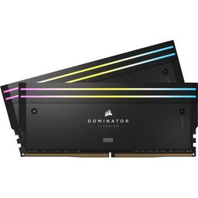
Asus ROG MAXIMUS Z790 DARK HERO Motherboard:
This is a premium motherboard with robust power delivery, excellent overclocking capabilities, and ample connectivity options. It's an ideal choice for gamers and enthusiasts who want the best from their system.
Corsair Dominator Titanium 96 GB DDR5 Memory:
The 96GB of DDR5 memory is a substantial amount, suitable for content creators, 3D rendering, and multitasking. DDR5-6600 memory ensures smooth performance and responsiveness.

Slide 16
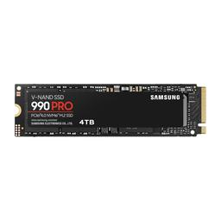
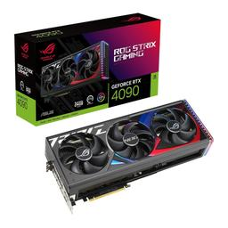
Samsung 990 Pro 4 TB NVMe SSD:
With 4TB of fast NVMe storage, you'll have ample space for games, applications, and large files. The PCIe 4.0 support ensures rapid data access, reducing load times in games and improving system responsiveness.
Asus ROG STRIX GAMING GeForce RTX 4090:
The RTX 4090 is an incredibly powerful GPU, capable of running the most demanding games at high resolutions and frame rates. It's an excellent choice for gamers who want the best gaming experience possible.

Slide 17
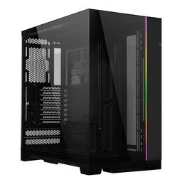
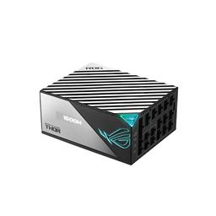
Lian Li O11 Dynamic EVO XL Case:
This full tower case offers ample space for components, good airflow, and supports various cooling options. Its sleek design is aesthetically pleasing and fits well with high-end components.
Asus ROG THOR 1600T 1600W Power Supply:
A 1600W power supply ensures there's plenty of headroom for the power-hungry CPU and GPU, especially when overclocked. The 80+ Titanium certification means it's highly efficient and reliable.

Slide 18
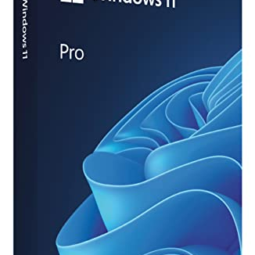
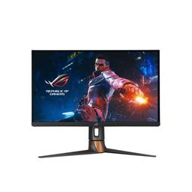
Windows 11 Pro Retail:
Windows 11 Pro offers advanced features and is suitable for professional use, making it a good choice for a high-end gaming and productivity system.
Asus ROG Swift 360Hz Monitor:
The 360Hz refresh rate monitor is perfect for competitive gamers who want ultra-smooth and responsive gameplay. The 2560x1440 resolution strikes a balance between image quality and high refresh rates.

Slide 19
Reasons for this design:
High-End Performance: The chosen components are top-tier and are geared towards providing the best gaming and multitasking experience possible.
Future-Proofing: This build is designed to remain relevant and powerful for several years, even as new games and applications become more demanding.
Aesthetics: The selection of Asus ROG components ensures a cohesive and stylish look for your gaming rig.
Overclocking: The motherboard, liquid cooler, and power supply offer the necessary support for overclocking, allowing you to push your components to their limits.
Budget Considerations: It's essential to note that this is a high-budget build. The component selection reflects a willingness to invest in top-tier hardware for the best possible gaming experience.
Build Link : https://pcpartpicker.com/list/FLB2xH

Slide 20
DESIGN AND VIDEO RENDERING PC

Slide 21
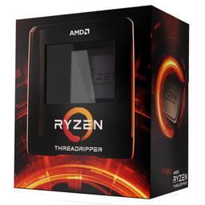
AMD Threadripper 3990X 64-Core Processor:
The Threadripper 3990X offers an incredible number of cores and threads, making it an excellent choice for heavy video editing, 3D rendering, and other demanding tasks. It's designed for professionals who require top-tier performance.
Asus ROG RYUJIN II ARGB Liquid CPU Cooler:
Liquid coolers are efficient at cooling high-end CPUs like the Threadripper 3990X. The additional features, such as ARGB lighting and a monitoring display, add to both the aesthetics and functionality of the system.

Slide 22
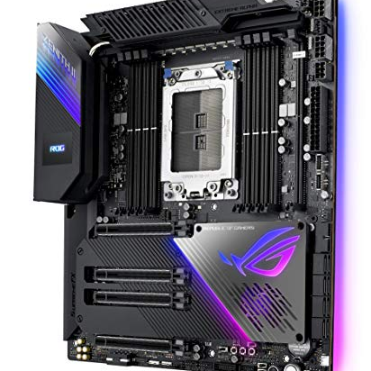
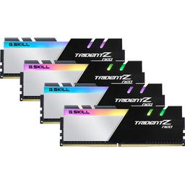
Asus ROG ZENITH II EXTREME ALPHA Motherboard:
This motherboard is tailored for Threadripper processors, offering robust power delivery, excellent connectivity, and support for multiple GPUs and high-speed storage. It's a premium choice for professionals.
G.Skill Trident Z Neo 64 GB DDR4 Memory:
The 64GB of fast DDR4 memory is ideal for multitasking and handling large media files. The CL14 timing ensures low latency, which is crucial for memory-intensive tasks.

Slide 23
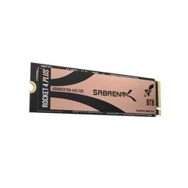
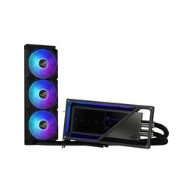
Sabrent Rocket 4 Plus 8 TB NVMe SSD:
With 8TB of high-speed NVMe storage, you have plenty of space for storing large video and project files. The PCIe 4.0 support ensures rapid data access and transfer speeds.
Asus ROG Matrix Platinum GeForce RTX 4090:
The RTX 4090 is a powerful GPU with dedicated hardware for video rendering tasks. It's suitable for tasks that require GPU acceleration, such as video editing and 3D rendering.

Slide 24
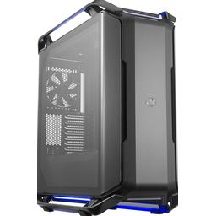
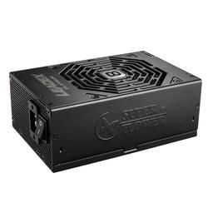
Cooler Master Cosmos C700P Black Edition Case:
This full tower case offers ample space for components, excellent airflow, and supports various cooling options. It's a sleek and functional choice for a high-end workstation.
Super Flower Leadex 2000W Power Supply:
A 2000W power supply provides ample headroom for the power-hungry CPU, GPU, and additional components. The 80+ Platinum certification ensures high efficiency and reliability.

Slide 25
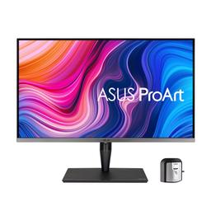
Windows 11 Pro Retail:
Windows 11 Pro offers advanced features and is suitable for professional use, making it a good choice for a high-end editing and rendering system.
Asus ProArt Display PA32UCG-K 4K Monitor:
This 32-inch 4K monitor with a 120Hz refresh rate offers excellent color accuracy and is suitable for professional photo and video editing. The high resolution and refresh rate ensure a smooth and detailed editing experience.

Slide 26
Reasons for this design:
Top-Tier Performance: The chosen components are the best in their respective categories and are designed to deliver outstanding performance in content creation and rendering tasks.
Professional Workload: The configuration is tailored for professional use, where time is money. It can handle complex rendering, editing, and other resource-intensive tasks with ease.
Future-Proofing: With the high core count CPU, ample RAM, and fast storage, this build is designed to remain powerful and relevant for years.
Budget Considerations: This is a high-budget build, reflecting the willingness to invest in top-tier hardware for professional use.
Build Link : https://pcpartpicker.com/list/qnhVFs

Slide 27
Budget PC for Collage Students

Slide 28
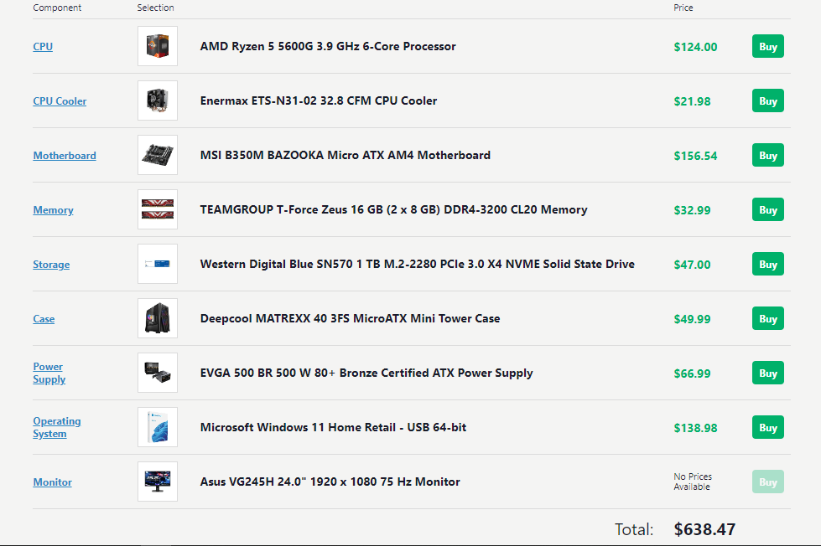

Slide 29
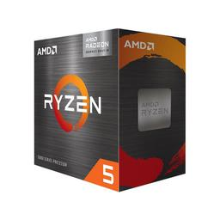
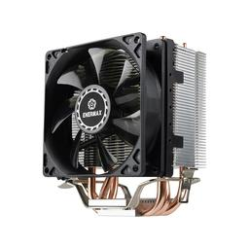
AMD Ryzen 5 5600G 6-Core Processor:
The Ryzen 5 5600G offers a good balance between cost and performance. It includes integrated Vega graphics, which can handle everyday tasks and some light gaming without the need for a dedicated GPU.
Enermax ETS-N31-02 CPU Cooler:
While the Ryzen 5 5600G comes with a stock cooler, adding an aftermarket cooler can help with cooling efficiency and potentially reduce noise levels. It's a budget-friendly cooling solution.

Slide 30
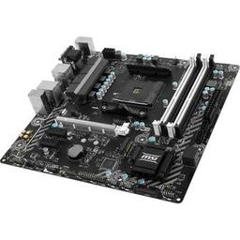
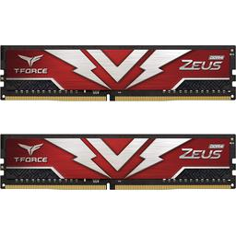
MSI B350M BAZOOKA Micro ATX Motherboard:
This motherboard is a cost-effective choice for the Ryzen 5 5600G, offering essential features for a budget build. Make sure it's compatible with the CPU; you might need a BIOS update.
TEAMGROUP T-Force Zeus 16 GB DDR4 Memory:
16GB of RAM is sufficient for most college tasks, including web browsing, word processing, and even some light content creation.

Slide 31
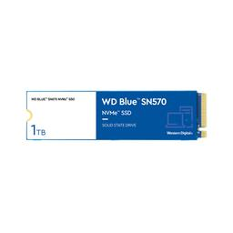
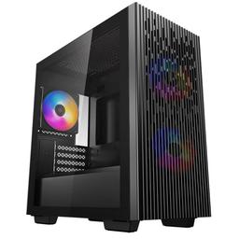
Western Digital Blue SN570 1 TB NVMe SSD:
This SSD provides fast storage for your operating system and applications. It will ensure that your system feels responsive and quick.
Deepcool MATREXX 40 3FS MicroATX Case:
This case is compact, making it suitable for smaller spaces like dorm rooms. It's also budget-friendly and has decent airflow for basic components.

Slide 32
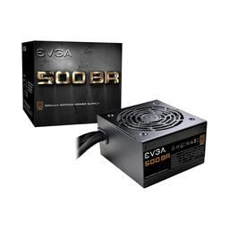
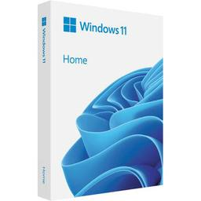
EVGA 500 BR 500W Power Supply:
The 500W power supply is adequate for the components in this build. It's budget-friendly and 80+ Bronze certified, meaning it's reasonably efficient.
Windows 11 Home Retail:
This operating system choice is suitable for students and includes most of the essential features. Ensure your college software and requirements are compatible with Windows 11.

Slide 33
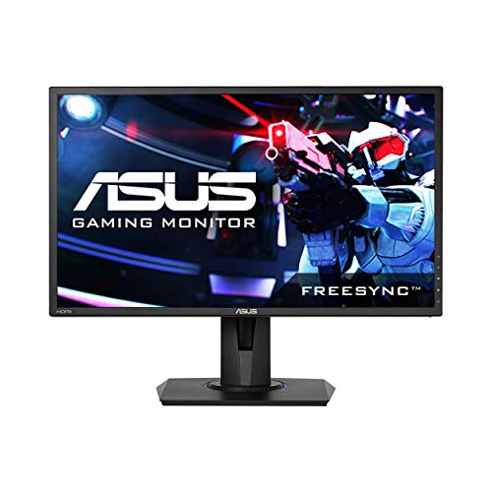
Asus VG245H 24" Monitor:
A 1080p monitor with a 75Hz refresh rate is a good choice for general use. It's budget-friendly and should work well for web browsing, document editing, and light gaming.

Slide 34
Reasons for this design:
Budget-Friendly: The component selection focuses on providing a functional system for college use while keeping costs down.
Integrated Graphics: The Ryzen 5 5600G's integrated Vega graphics allow for gaming at a basic level and eliminates the need for a dedicated GPU, which can be a significant cost savings.
Sufficient RAM and Storage: 16GB of RAM and a 1TB NVMe SSD provide a balance between performance and capacity for college tasks.
Compact and Practical Case: The MicroATX case is a practical choice for a college student, especially if space is limited.
Energy Efficiency: The 80+ Bronze certified power supply is reasonably efficient and will help save on energy costs over time.
Build Link : https://pcpartpicker.com/list/xvXjn6

Slide 35
MACHINE LEARNING PC

Slide 36
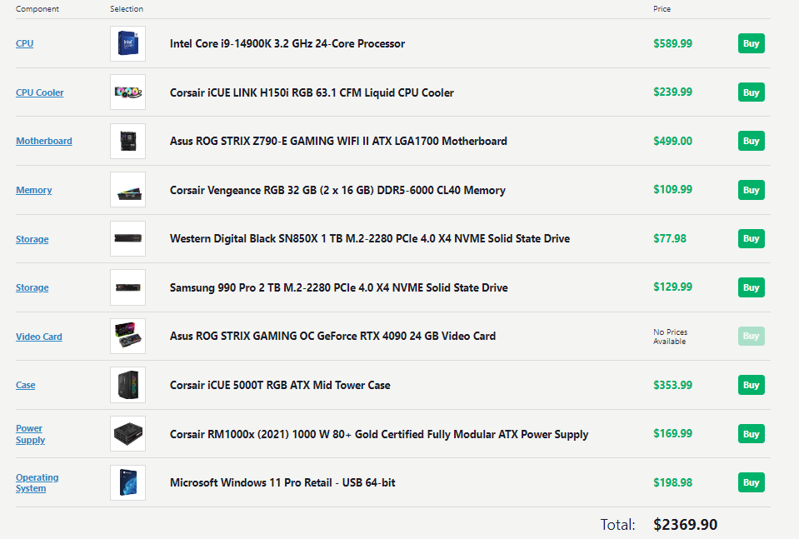

Slide 37
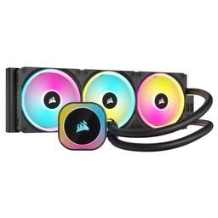
Intel Core i9-14900K 24-Core Processor:
The i9-14900K is a high-performance CPU with 24 cores, which is beneficial for parallel processing tasks in machine learning. It provides a balance between gaming and machine learning capabilities.
Corsair iCUE LINK H150i RGB Liquid CPU Cooler:
Machine learning tasks can be CPU-intensive. The liquid cooler ensures that the CPU remains cool during extended processing periods, preventing thermal throttling.

Slide 38
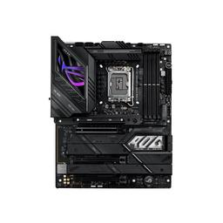
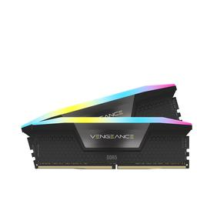
Asus ROG STRIX Z790-E GAMING WIFI II Motherboard:
This motherboard offers robust power delivery, multiple PCIe slots for GPUs, and built-in Wi-Fi, making it suitable for machine learning workloads that may involve multiple GPUs.
Corsair Vengeance RGB 32 GB DDR5 Memory:
While 32GB may be considered somewhat low for machine learning, the DDR5-6000 memory provides high bandwidth and responsiveness. You can expand the RAM later if needed.

Slide 39
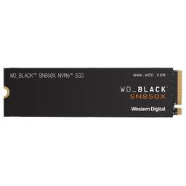
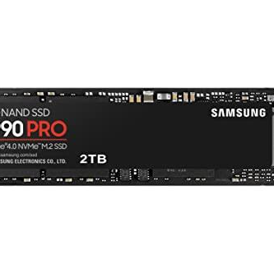
Western Digital Black SN850X 1 TB NVMe SSD:
A fast and spacious NVMe SSD for your primary drive ensures quick data access and loading times, which can be important for large datasets.
Samsung 990 Pro 2 TB NVMe SSD:
The additional 2TB SSD provides extra storage for datasets, models, and other data, allowing you to work with larger datasets.

Slide 40
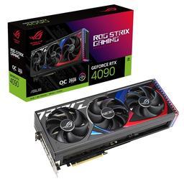
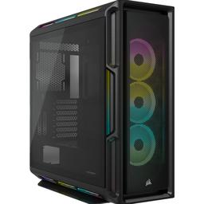
Asus ROG STRIX GAMING OC GeForce RTX 4090:
The RTX 4090 is a powerful GPU with dedicated hardware for machine learning tasks. It's excellent for training deep learning models and running GPU-accelerated computations.
Corsair iCUE 5000T RGB Mid Tower Case:
This case offers a blend of aesthetics, airflow, and functionality. It has ample room for components and supports good cable management.

Slide 41
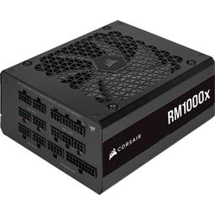
Corsair RM1000x 1000W Power Supply:
A 1000W power supply provides sufficient power for the CPU, GPU, and potential additional components. It's a reliable and efficient choice.
Windows 11 Pro Retail:
Windows 11 Pro offers advanced features and is suitable for professional use, including machine learning development and data analysis.

Slide 42
Reasons for this design:
Machine Learning Performance: The configuration is designed to provide excellent machine learning performance, with a powerful CPU, ample RAM, and a high-end GPU.
Budget Considerations: It appears to be a balanced build, not overly extravagant but still capable of handling most machine learning tasks.
Storage Configuration: The use of both a 1TB and a 2TB NVMe SSD ensures fast access to data, which is important for machine learning workloads.
Expandability: The system allows for future expansion, both in terms of RAM and additional storage.
Balanced Components: The components are well-matched, ensuring that no single part is a significant bottleneck for machine learning tasks.
Aesthetics: The choice of RGB components and a well-designed case adds aesthetics to the build without compromising performance.
Build Link : https://pcpartpicker.com/list/yx4rMV

Slide 43
NAS SERVER PC

Slide 44
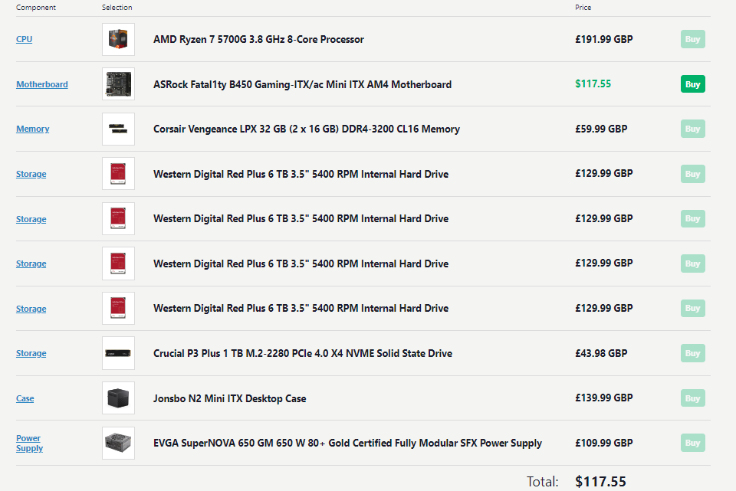

Slide 45
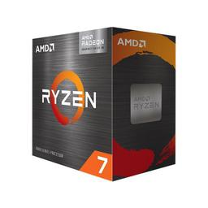
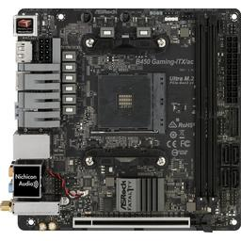
AMD Ryzen 7 5700G 8-Core Processor:
The Ryzen 7 5700G is a powerful APU (Accelerated Processing Unit) with built-in Vega graphics. While you might not need the graphics for a NAS, the 8 CPU cores provide ample processing power for file transfers and network management.
ASRock Fatal1ty B450 Gaming-ITX/ac Motherboard:
A Mini ITX motherboard is compact and well-suited for a NAS build where space may be limited. The B450 chipset offers sufficient features for a NAS setup.

Slide 46
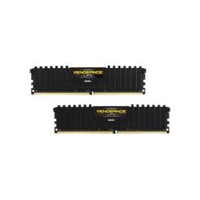
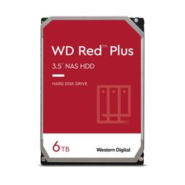
Corsair Vengeance LPX 32 GB DDR4 Memory:
32GB of RAM is a reasonable choice for a NAS, ensuring smooth multitasking and responsiveness when handling file transfers and other network tasks.
Western Digital Red Plus 6 TB Hard Drives:
These drives are specifically designed for NAS use. They are optimized for 24/7 operation, provide excellent reliability, and are energy-efficient. With a total of 24TB storage capacity, you have ample space for your data.

Slide 47
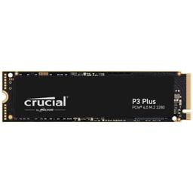
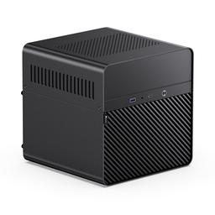
Crucial P3 Plus 1 TB NVMe SSD:
The SSD can be used for caching, which can significantly improve the performance of a NAS by accelerating frequently accessed files. It's a good choice to improve overall responsiveness.
Jonsbo N2 Mini ITX Case:
The Mini ITX form factor is ideal for a compact NAS build. This case provides enough space for your components, and it's designed with a focus on airflow and cooling.

Slide 48
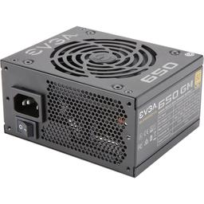
EVGA SuperNOVA 650 GM 650W SFX Power Supply:
The 650W power supply is more than enough for this build, and the SFX form factor is suitable for smaller cases like the Jonsbo N2. It's also 80+ Gold certified, which ensures efficiency and reliability.

Slide 49
Reasons for this design:
Compact and Efficient: The Mini ITX form factor and energy-efficient components are well-suited for a home NAS setup, where space and power efficiency are important.
NAS-Optimized Drives: The use of Western Digital Red Plus drives ensures reliability and performance for NAS storage.
SSD for Caching: The SSD for caching can significantly speed up data access for frequently used files.
Adequate Memory: 32GB of RAM provides enough memory for handling file transfers and other network-related tasks effectively.
Budget Considerations: While NAS setups can become expensive, this build appears to balance the need for performance and capacity with a reasonable budget.
Build Link : https://pcpartpicker.com/list/JC3h7R

Slide 50
Thanks!
Group Members :
● Hammam Abdulllah Saeed (12)
● Faiz Atho’illah M. (17)
● Ahmad Adzin B. L. K. (2)
● M.Taqqiyuddin tsaqif (20)
● Ridho Anfa’al (23)
Please keep this slide for attribution

